Slide 1
Encouraging Resilience Through Peer and Instructor Support

Slide 2
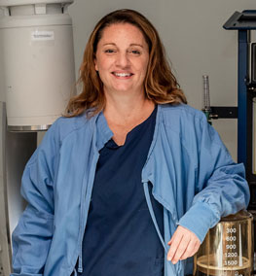
Anna Campbell
CST/CSFA, CRCST
BA, MSEd, PhD (May 2023!)
Masters Online Teaching Certificate
Certified Mental Health First Aid

Slide 3
“The Great Resignation”
Since February 2021, more than 5 million workers have quit their jobs
The healthcare industry is one of the hardest hit
  20 percent of the workforce over the past two years
Overall, healthcare employment is down by an estimated 500,000 workers

Slide 5
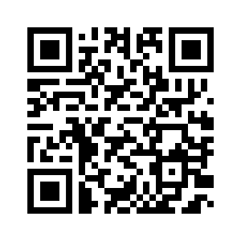
To submit your answers, use your camera and scan the QR code below to open Poll Everywhere, or go to PollEv.com and enter AnnaCampbell298
https://www.polleverywhere.com/free_text_polls/UWAsfnJLLai04jEa9nzGQ

Slide 6

Transformative Learning

Slide 7



Dilemma
Critical Reflection
Discourse

Slide 8
49% of Americans agree that the fear of failure prevents them from achieving or revisiting their goals

Slide 10

Motivation
Resilience
Support
Challenge

Slide 11


Slide 12



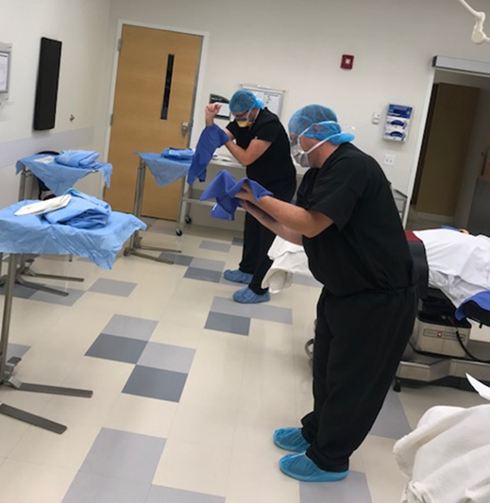

Slide 13


Slide 14


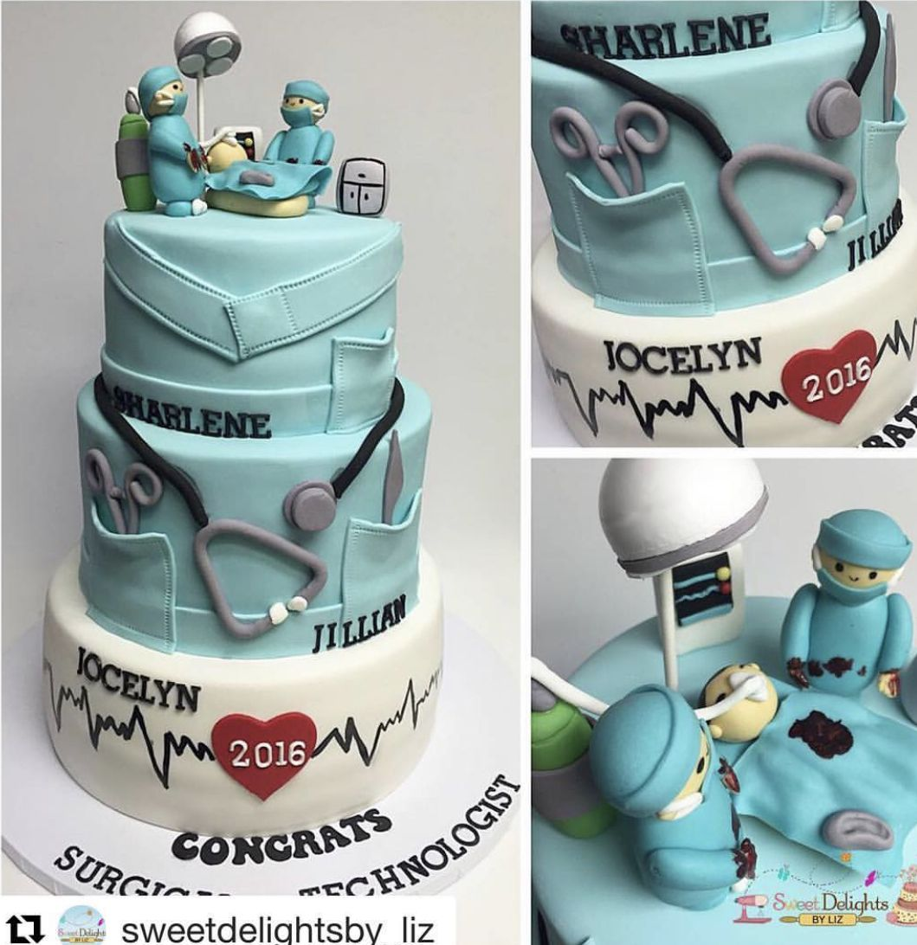

Slide 15
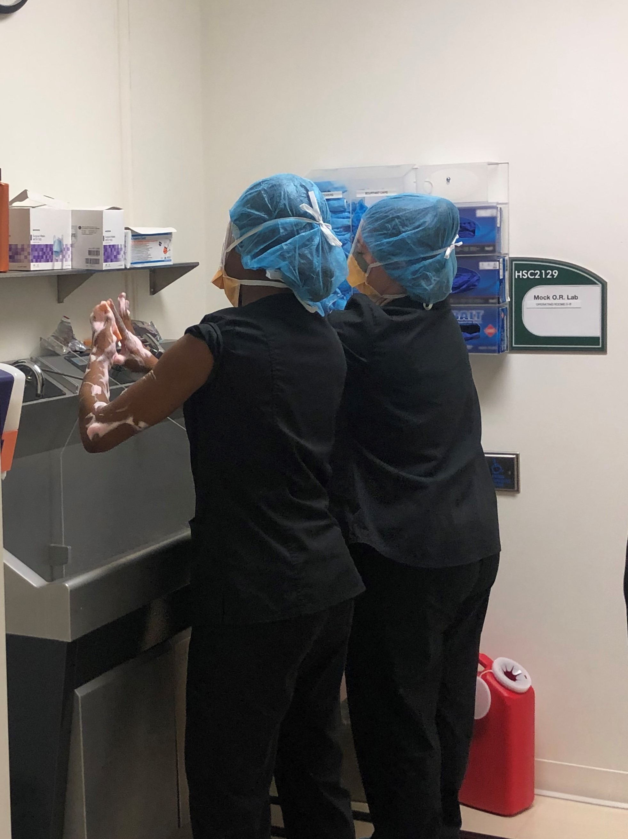
“We must fail in here so we don’t fail out there.”

Slide 16
Transformative Learning
Dilemma (failure)
Critical Reflection
Communication
Resilience
Motivation
Challenge
Support
Surgical Technology Success

Slide 17


